Slide 1

Refining initial points for k-means clustering

Slide 2
Introduction
Various clustering algorithms like K-Means, EM etc. use an iterative procedure to converge to a local minima. But these algorithms are sensitive to the starting initial conditions.
We’ll show a method for computing refined initial conditions which allows the algorithms to converge to a better local minima.
We generally use big data for clustering so this method is very effective for clustering it.

Slide 3
What is Clustering
The fundamental clustering problem is grouping of items which are similar to each other.
Clustering is an important area of application for a variety of fields including data mining, statistical analysis, statistical data analysis , compression , and vector quantization.
The K-means algorithm find local minima using minimizing sum of the L-2 distance squared between each data point and its nearest cluster center and then groups the data points into clusters.
The basic algorithm works as follows:
1) Initialize the model parameters to a current model;
2) Decide memberships of the data items to clusters, assuming that the current model is correct;
3) Re-estimate the parameters of the current model assuming that the data memberships obtained in 2) are correct, producing new model;
4) If current model and new model are sufficiently close to each other, terminate, else go to 2).

Slide 4
The refinement algorithm
we take multiple subsamples, say J, are drawn and clustered independently producing J estimates of the true cluster locations. To avoid the noise associated with each of the J solutions, we employ a “smoothing” procedure
The algorithm initially chooses J small random sub-samples of the data, Si , i=1,. . . ,J. The subsamples are clustered via K-Means.
The sets CMi , i=1,…,J are these clustering solutions over the sub-samples which form the set CM. CM is then clustered via K-Means initialized with CMi producing a solution FMi . The refined initial point is then chosen as the FMi having minimal distortion over the set CM.

Slide 5
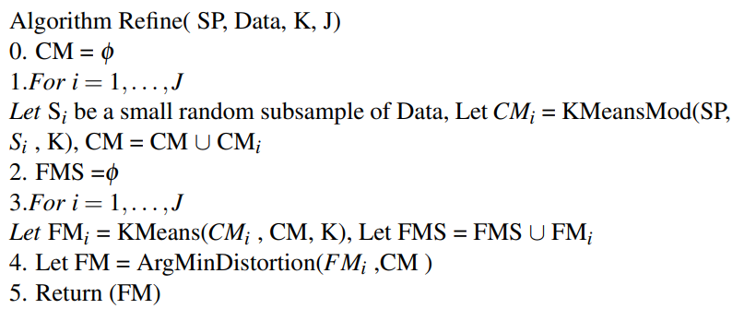
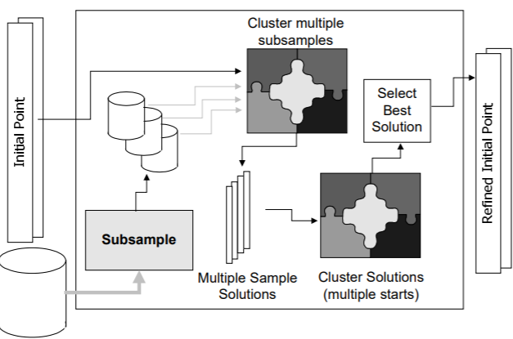

Slide 6
Computational Complexity
When working over small datasets applying the classic K-Means algorithm from many different starting points is a feasible option.
However, as database size increases (especially in dimensionality), efficient and accurate initialization becomes critical. A clustering session on a data set with many dimensions and tens of thousands or millions of records can take hours to days.
Since our method works on very small samples of the data (as we divide them into J subsamples), the initialization is fast . For example, if we use sample sizes of 1% (or less) of the full dataset size, trials over 10 samples can be run in time complexity that is less than 10% of the time needed for clustering the full database. For very large databases, the initial sample becomes negligible in size.

Slide 7
Results on data
We created a synthetic data for dimension d = 2, 3, 4, 5, 10, 20, 40, 50 and 100. For a given value of d, data was sampled from 10 Gaussians (hence K=10).
Methodology:-The goal of this experiment is to evaluate how close the means estimated by classic K-Means are to the true Gaussian means generating the synthetic data.
We compare 3 initializations:
No Refinement: random starting point chosen uniformly on the range of the data.
Refinement (J=10): a starting point refined from (1) using our method. The size of the random subsamples being 10 percent of full dataset size and the number of subsamples taken being 10.
Refinement (J=1): same as 2 but over a single random subsample of size 10 percent.

Slide 8
results
1. For dimensions 2-50, the refinement method (Refined (J=10)) always did better than the random starting point (Unrefined) and the point refined over 1 subsample (Refined (J=1)).
2. For dimension 100, in 9 of the 10 independent trials refinement method did better than the random starting point.
3. Refiner solutions are between 2.34 (d=3) and 6.44 (d=50) times closer to the true Gaussian means than solutions from the random initial point and between 1.09 (d=3) and 4.80 (d=50) times closer than solution computed from “Refined (J=1)” initial point.

Slide 9
